Slide 1
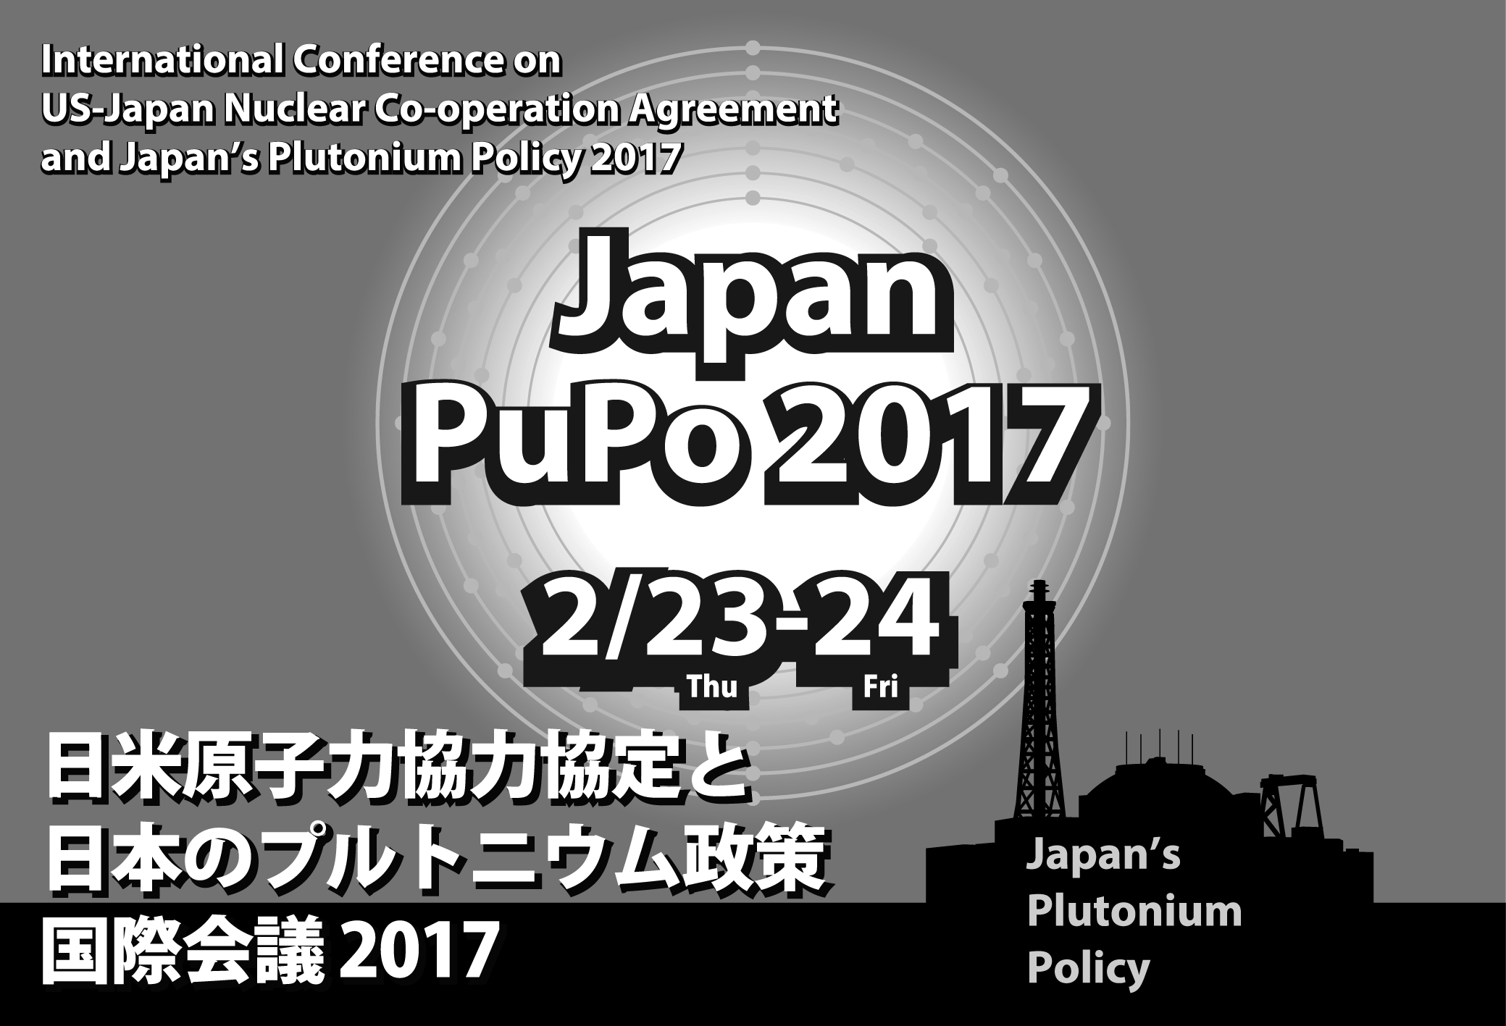
Session 2 Feb 23 12.50 - 14.50
Japan’s Plutonium Policy
Nobuyasu Abe; All personal views
In the first place, what’s the problem with the Japanese Pu?
Do you think Japan is going to make nuclear bombs with the Pu?
Japan would have done so many decades ago if it wanted and Japan would have done so with higher-grade Pu rather than the low reactor-grade Pu.

Slide 2
Still, Japan should not be possessing so much Pu for the nuclear security (terrorist) concern.
Japan has signed up to the Hague statement committing to reduce Pu stockpile. Watch Pu balance pronouncement, i.e. balance should be gradually reduced or at least should not be increase.
Some are more concerned about the 11 ton Pu in Japan than the Pu overseas. (Proliferation concern.)
If that is the concern, Japan may ask France, UK or US to keep its Pu.
Wherever it is, the Pu is a nuclear security risk.
Build a Pu Fort Knox, possibly in US.

Slide 3
Japan itself is not a concern but allowing Japan to reprocess and possess Pu makes it difficult to dissuade other countries from reprocessing and Pu possessing.
Most difficult question to refute. The Japanese experience (questionable economic viability, low immediate Pu requirement) would be a good lesson for other countries to learn from. “Don’t repeat the Japanese mistake.”

Slide 4
Current GOJ nuclear fuel cycle policy= “Stay the course except for the Monju.”= reprocessing, MOX, vitrify & put in permanent repository.
Please read between the lines. (purely, purely personal)
Monju alone was such a big painful decision. (Resistance from the nuclear village, complaints from the local governments, consequence management)
Expanded interim storage spaces will allow a more time to decide what to do with the spent fuel.
Ministers decided to continue fast reactor research. AEC; “No rush. Has to be economically viable.”

Slide 5
Remaining problems that need to be overcome.
What to do with the spent fuel accumulating?
What to do with the over 2 trillion yen sunk cost?
What to do with the local governments?
“We need to continue reprocessing to preserve our right gained under the U.S.-Japan bilateral 123 agreement.”

